Slide 1
3D Virtual Scene Navigation Using a 2D Minimap and Object Detection
Jack Dewey, Aakash Mahesha, Sam Tripathi

Slide 2
Abstract
Designed and implemented a program for navigating a player character in a 3D video game environment toward in-game objectives, using only onscreen visual information.
Leveraged a common onscreen display element, the 2D "minimap", to efficiently retrieve routing information that can be translated into input commands to the player character.
Implemented 3D object detection, in combination with an algorithm that allows our program to adjust its input commands based on whether there is an object obstructing our path.

Slide 3
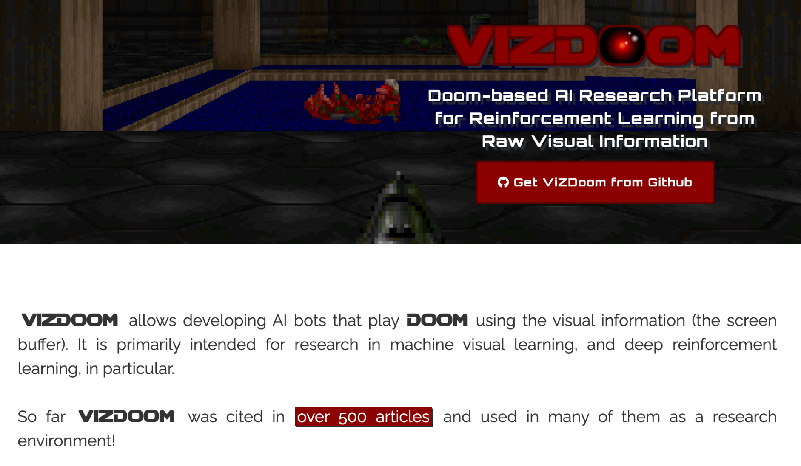

Background: Playing Video Games Using Only the Screen

Slide 4
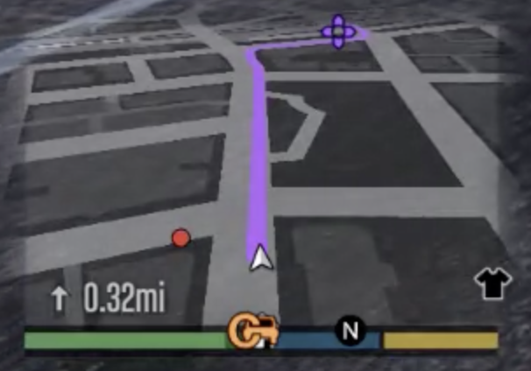
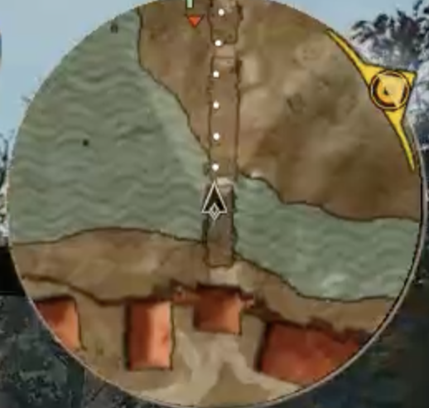
Approach: Minimap

Slide 5
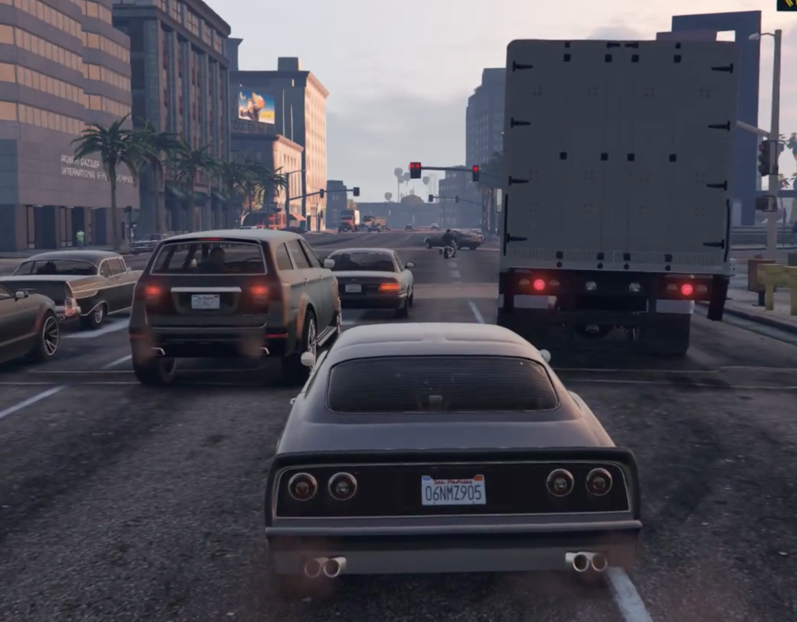
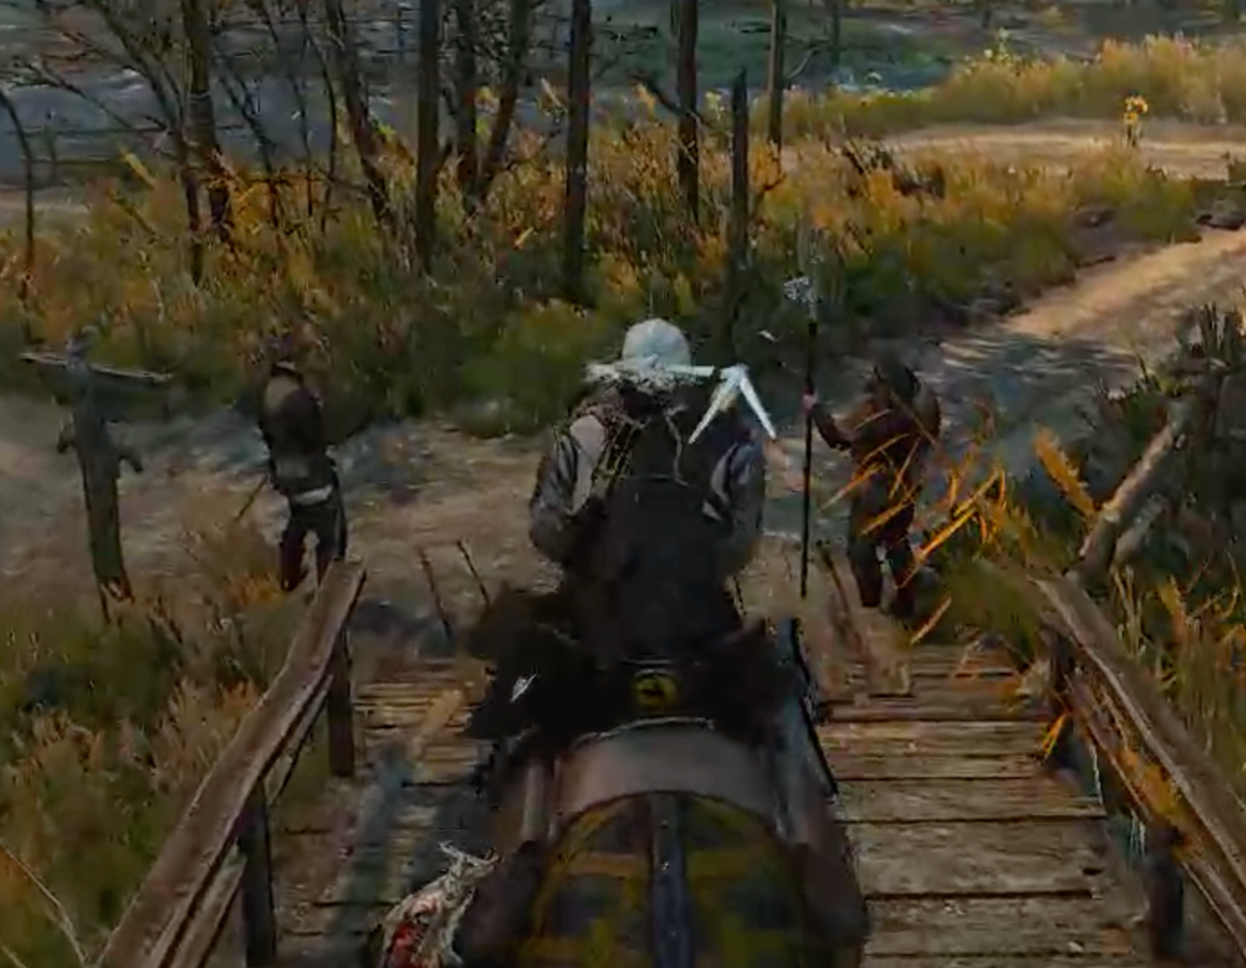
Approach: Object Detection

Slide 6
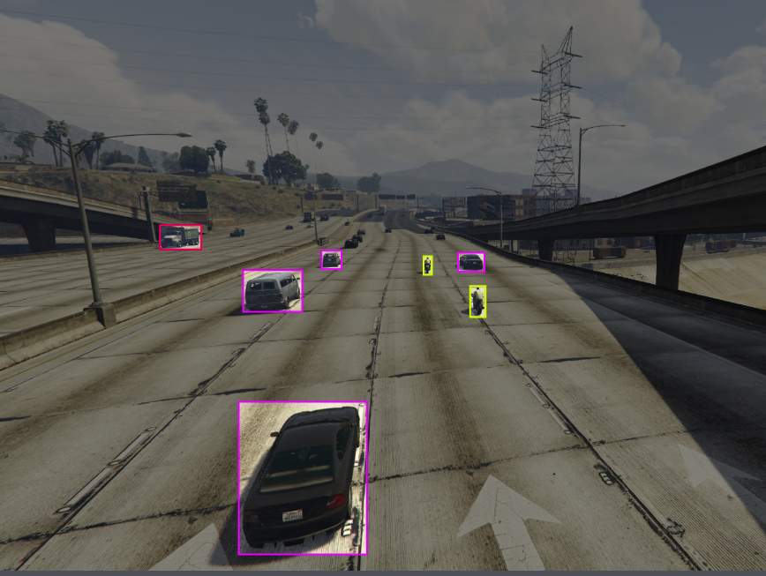
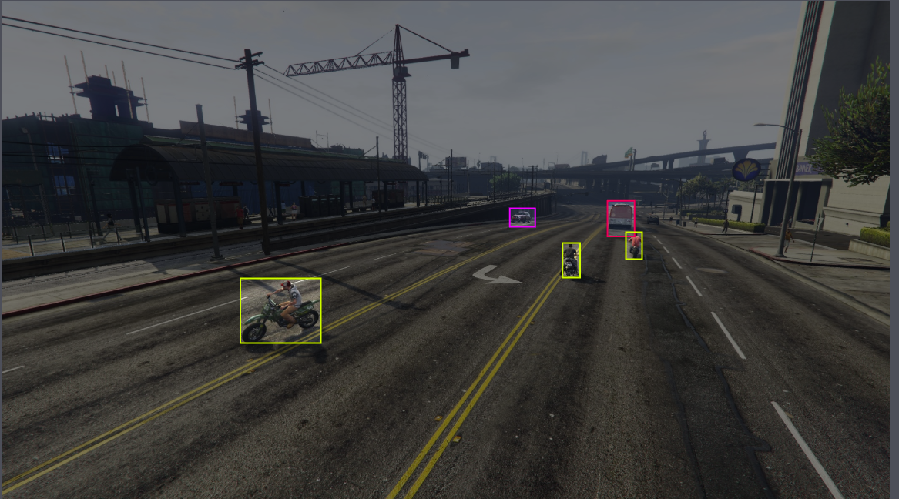
Object Detection on GTA-V
Implemented the state-of-the-art YOLOv5 Object detection model for detecting vehicles.
Trained on GTA-V Vehicle Dataset from Roboflow.com

Slide 7
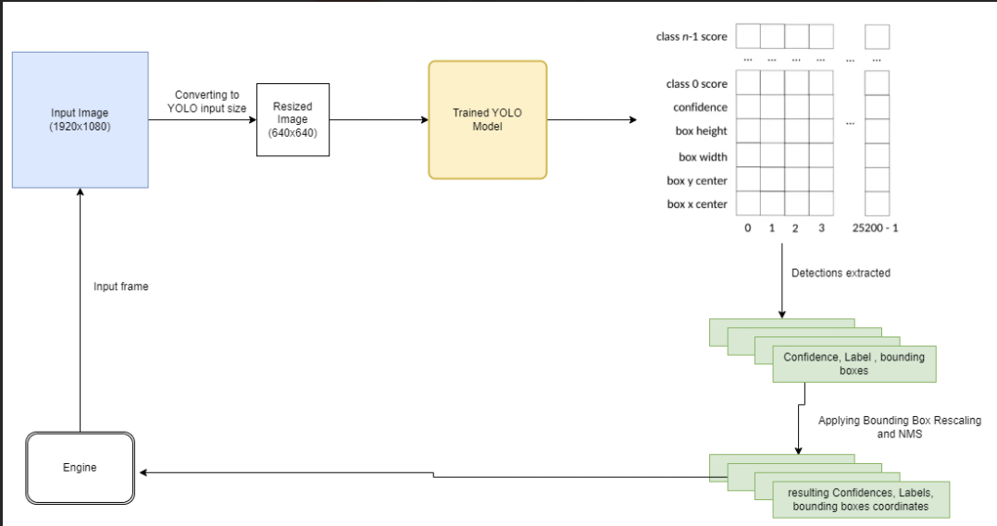

Slide 8
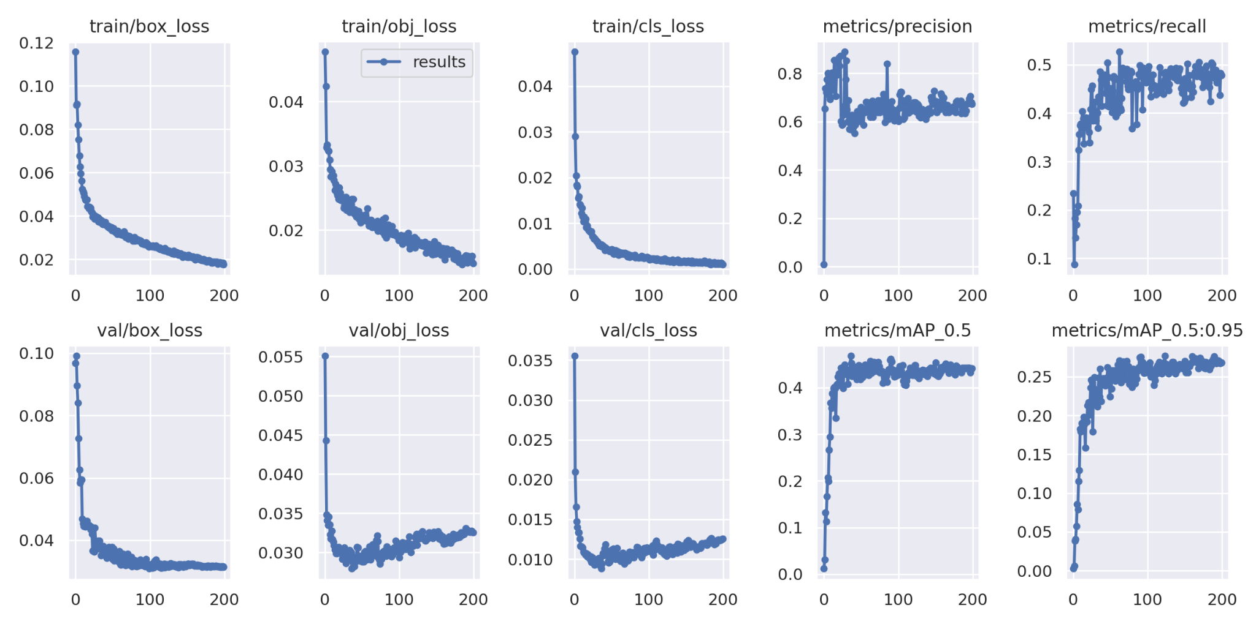
YOLOv5 Performance

Slide 9
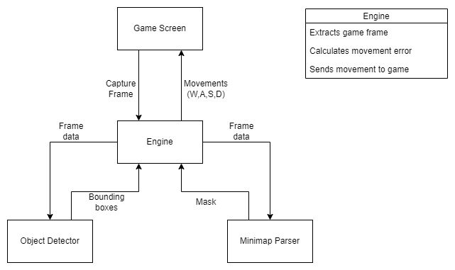
Feedback Loop for the player
Error from minimap parsing (Global Path)
Error from Object detection (Local Path)
We take the sum of the errors and then normalize it.
This value is then used to determine which key and how long to press it (note: we only consider lateral movements A,D since W key is almost always pressed)

